Slide 1
Welcome
To our presentation About
Online Education System Project

Slide 2



Let’s introduce our team
Team members
Safwan Ishrak (ASH2001029M)
Md. Kutub Uddin Abir (MUH2001009M)
Farman Arefin Tamim (ASH2001043M)

Slide 3
The main aim of our project
Our online education platform streamlines education with roles for admins, teachers, and students. Admins manage users, log trails, and system data. Teachers create classes, upload materials, and communicate. Students sign up, engage with quizzes, download materials, and connect with peers and teachers, fostering a collaborative and efficient virtual learning environment.

Slide 4
Technology stack we will use in our system
Programming Language we will use in our project :
1. HTML, CSS, JAVASCRIPT(Frontend)
2. PHP (Backend as a Service)
3. MySQL (Relational Database)
Software :
1. VS Code (as editor)
2. Git and Github (For version control)
3. Xampp (Control panel)
4. Apache (local web server)
5. Figma (For UI/UX design)
6. Browser (Google Chrome)

Slide 5

Responsivness
This system also has a responsive design compatible with mobile devices and others.

Slide 6
Users of this System
Admin
Students
.
The admin is in charge of maintaining important data such as the list subject, classes, department, and etc.
Students can answer the teacher's given practice quiz and limited to the teacher's allotted duration for taking the quiz.
There are 3 types of Users in this system.
Teachers
Using this system the faculties or teacher can provide soft copies of learning documents to the students and also he/she can create a Practice Quiz and Assignment for a class.

Slide 7
For the admin side of the system
In this section admin can perform four basic operation CRUD which stands for Create, Read , Update and Delete
.
Add, edit, delete student information
Add, edit, delete teacher information
Add an entry like the subject, class, school calendar
View log-in trail of every user
View logs of every user activity
.

Slide 8
For the Teacher User of the System
The teacher can create his/her Class
After creating a class the teacher View the students for that particular class
Upload Downloadable materials for his/her class
Create practice quizzes for students
Grade students assignment
Post announcements
Create a class calendar of events
Message co-teacher or students
60%

Slide 9
For the Student user of the system
Sign up for his / her account
Can view classmates in his / her class
Answer practice quizzes
View evaluation of assignment and quizzes
Download downloadable materials in a class
Upload downloadable material (Assignment)
Message a teacher or his/ her classmate
60%

Slide 10
Admin
Record Analysis
Record Analysis
Teacher Signup
Student Signup
Online Education
Website
Student Login
Teacher Login
Teacher
Student
Student Logout
Teacher Logout
Class Details
Grade Submission

Slide 11
All Records
Student info
Online Education Website
Student info
Database
Student
Verify Document
Student enrollment
Add/Update/Delete
Admin
Providing Student id
Course Manage-ment
Add/Update/Delete
Assignment and Quiz managemnt
Update course
details
Teacher

Slide 12
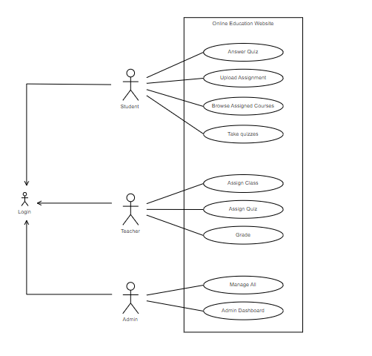
Low Level Architecture

Slide 13





High Level Architecture
Server
Databases Cluster
Client

Slide 14
THANK YOU

